Slide 1
Smart Watering System

Slide 2
INTRODUCTION:
Green environment has become a very vital and enthusiastic concept in the present world. Everybody keen to maintain a green surrounding at any point of the earth. Apart from that agricultural and cultivation needs are very vital in present heavy moving society.
Since the workforce in agricultural field is very small and the cost of labour has become very high alternative methods should be introduced to maintain the Green Concept. It is not only limited to the commercial sector but for the home needs also. Most of the people do not have reasonable spare time to look after their home gardens because of their very busy schedules in the life. Watering, fertilizing, maintaining are some of the basic needs that we have to provide to have a nice looking greenish and blooming garden. Lak of time has created a problem in maintaining such environment.
Therefore, some technical and networking methods should be introduced to the society as suitable for their fast-moving lives.

Slide 3
Give data to
Moisture sensor
Give data to
Wi-Fi module
Android app
Give data to
Arduino
Uno
Give power to
Power supply
Give command
motor

Slide 4
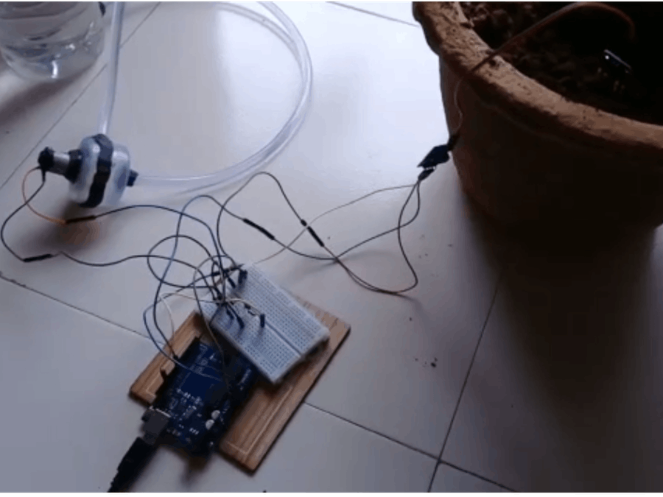
External view

Slide 5
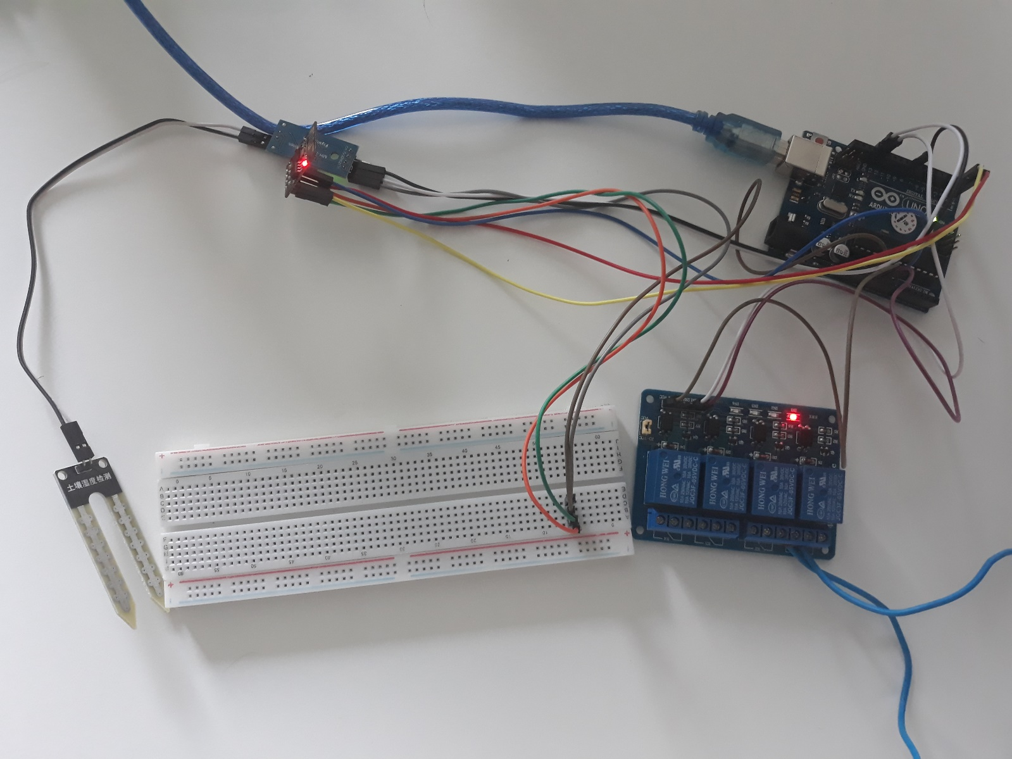

Slide 6
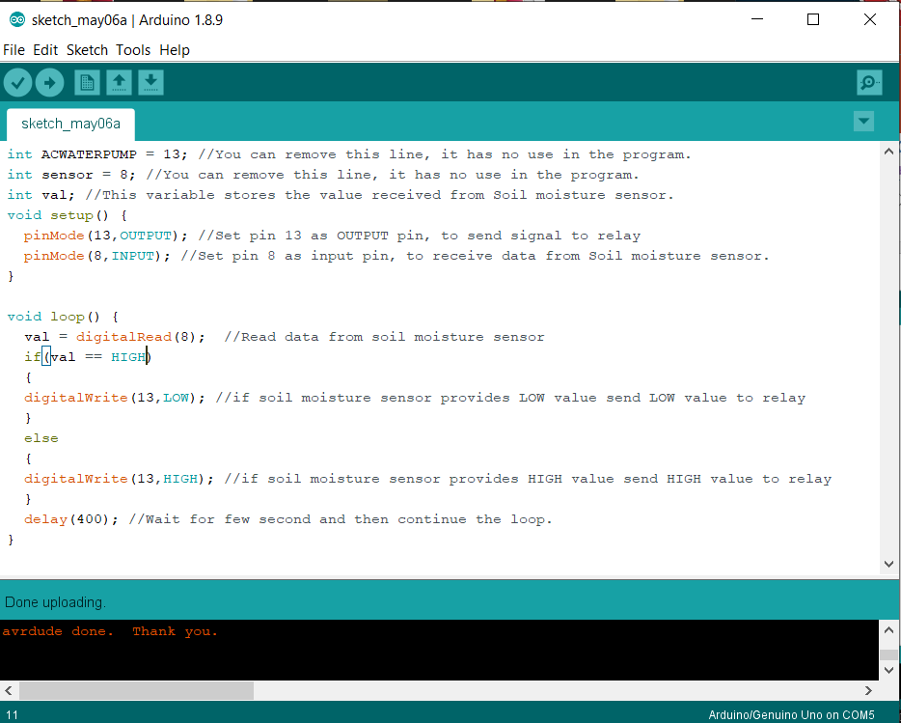
Arduino Source Code

Slide 7
the application is very user friendly one with several options. User can see the need of the watering on their fingertips. The present water level of each plant shall be monitored by the user through this application. Then the required amount of water will be automatically calculated by the application and also be noticed to the user. The watering process can be done by clicking some buttons and that can be done even at the moments where the user is far away from the plant. Physical access of the gardener or the planter does not need to do the watering plants. The watering system of the plant or the garden or the plantation has to connect with the application.
The said application is compatible only with the android devices such as phones and tabs. It may be further developed in the future as compatible with other smart devices.

Slide 8
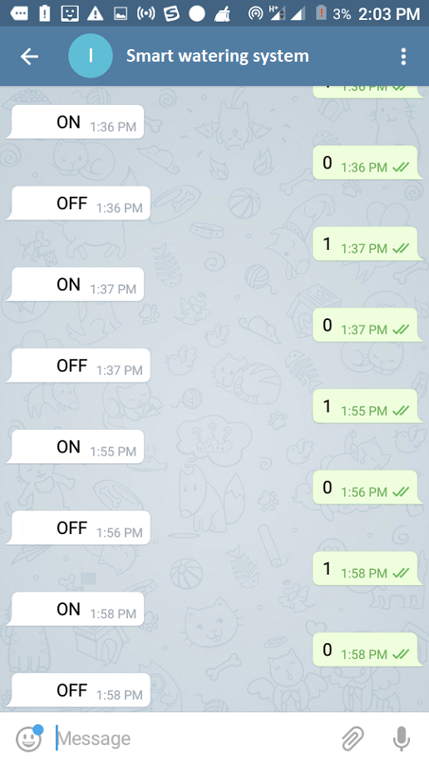

Slide 9
Thank
You

